Slide 1
08.1. Bootstrap
Theory and Practice of Bioinformatics
Jia-Ming Chang, CS.NCCU
The slide is only for educational purposes. If any infringement, please contact me. We will correct immediately.

Slide 2
Bootstrap

Slide 3
Stage 5: Evaluating trees : bootstrapping
Bootstrapping is a commonly used approach to measuring the robustness of a tree topology. Given a branching order, how consistently does an algorithm find that branching order in a randomly permuted version of the original data set?

Slide 4
Felsenstein, J. Evolution 39, 783–791 (1985).
Number 41 on the list is a description of how to apply statistics to phylogenies.
In 1984, evolutionary biologist Joe Felsenstein of the University of Washington in Seattle adapted a statistical tool known as the bootstrap to infer the accuracy of different parts of an evolutionary tree. The bootstrap involves resampling data from a set many times over, then using the variation in the resulting estimates to determine the confidence for individual branches.
Although the paper was slow to amass citations, it rapidly grew in popularity in the 1990s and 2000s as molecular biologists recognized the need to attach such intervals to their predictions.
Credit by The top 100 papers. Van Noorden R, Maher B, Nuzzo R. Nature. 2014 Oct 30;514(7524):550-3

Slide 5
Felsenstein, J. Evolution 39, 783–791 (1985).
Felsenstein says that the concept of the bootstrap, devised in 1979 by Bradley Efron, a statistician at Stanford University in California, was much more fundamental than his work. But applying the method to a biological problem means it is cited by a much larger pool of researchers. His high citation count is also a consequence of how busy he was at the time, he says: he crammed everything into one paper rather than publishing multiple papers on the topic, which might have diluted the number of citations each one received. “I was unable to go off and write four more papers on the same thing,” he says. “I was too swamped to do that, not too principled.”
Credit by The top 100 papers. Van Noorden R, Maher B, Nuzzo R. Nature. 2014 Oct 30;514(7524):550-3

Slide 6
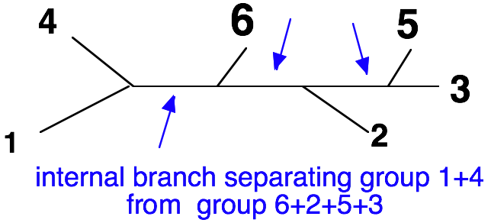
Reliability of phylogenetic trees: the bootstrap
The phylogenetic information expressed by an unrooted tree resides entirely in its internal branches.
The tree shape can be deduced from the list of its internal branches.
Testing the reliability of a tree = testing the reliability of each internal branch.
Adapted from Cedric Notredame

Slide 7
Stage 5: Evaluating trees: bootstrapping
To bootstrap, make an artificial dataset obtained by randomly sampling columns from your multiple sequence alignment. Make the dataset the same size as the original. Do 100 (to 1,000) bootstrap replicates.
Observe the percent of cases in which the assignment of clades in the original tree is supported by the bootstrap replicates.
>70% is sometimes considered significant.

Slide 8
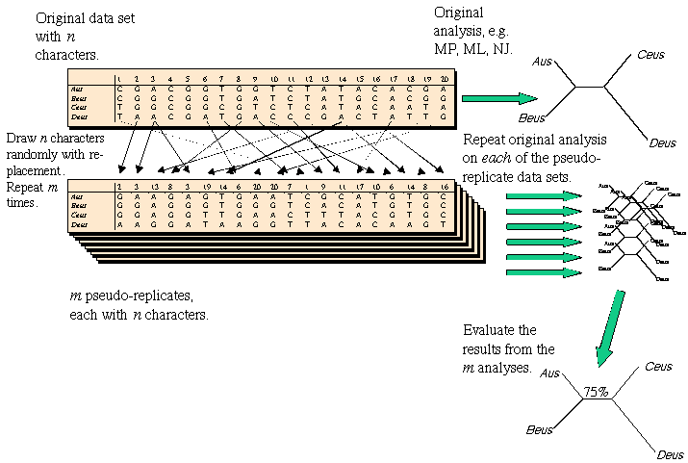
Bootstrap
http://artedi.ebc.uu.se/course/X3-2004/Phylogeny/Phylogeny-Credibility/Phylogeny-Credibility.html

Slide 9
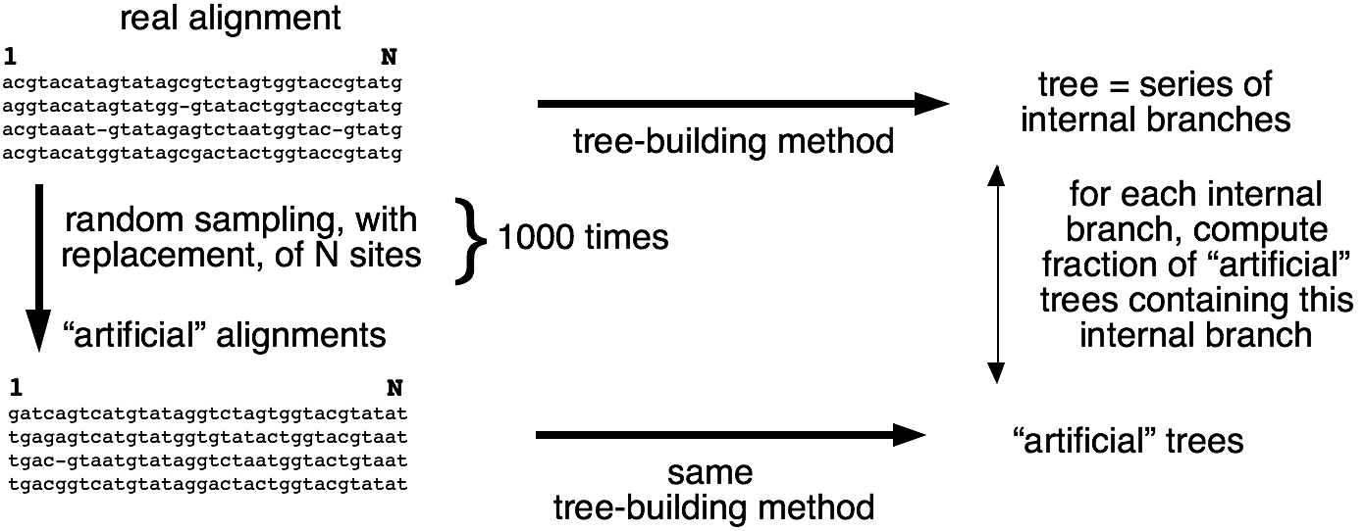
Bootstrap procedure
The support of each internal branch is expressed as percent of replicates.
Adapted from Cedric Notredame

Slide 10
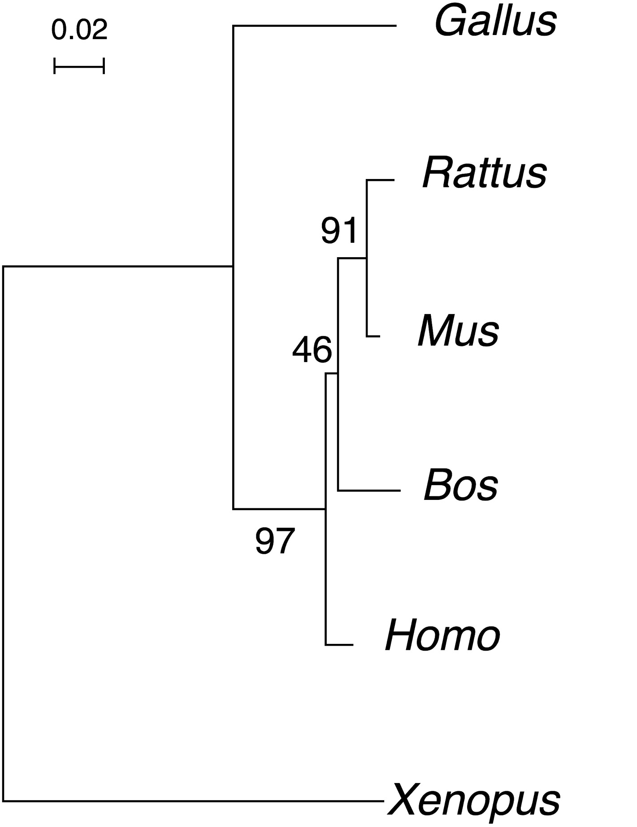
"bootstrapped” tree
Adapted from Cedric Notredame

Slide 11
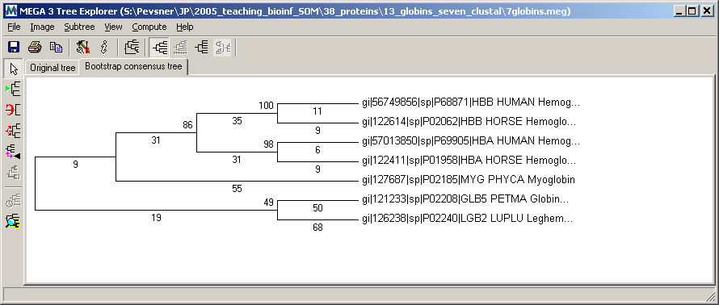
MEGA trees display bootstrap values
Bootstrap values show the percent of times each clade is supported after a large number (n=500) of replicate samplings of the data.

Slide 12
Bootstrap procedure : properties
Internal branches supported by ≥ 90% of replicates are considered as statistically significant.
The bootstrap procedure only detects if sequence length is enough to support a particular node.
The bootstrap procedure does not help determining if the tree-building method is good. A wrong tree can have 100 % bootstrap support for all its branches!
Adapted from Cedric Notredame

Slide 13
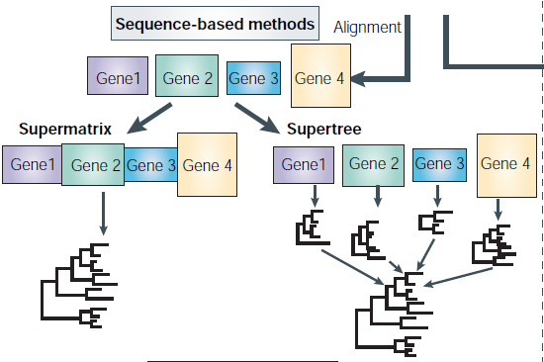
Supermatrix vs supertree
Phylogenomics and the reconstruction of the tree of life. Frédéric Delsuc, Henner Brinkmann, Hervé Philippe (2005) Nature reviews. Genetics 6 (5) p. 361-75

Slide 14
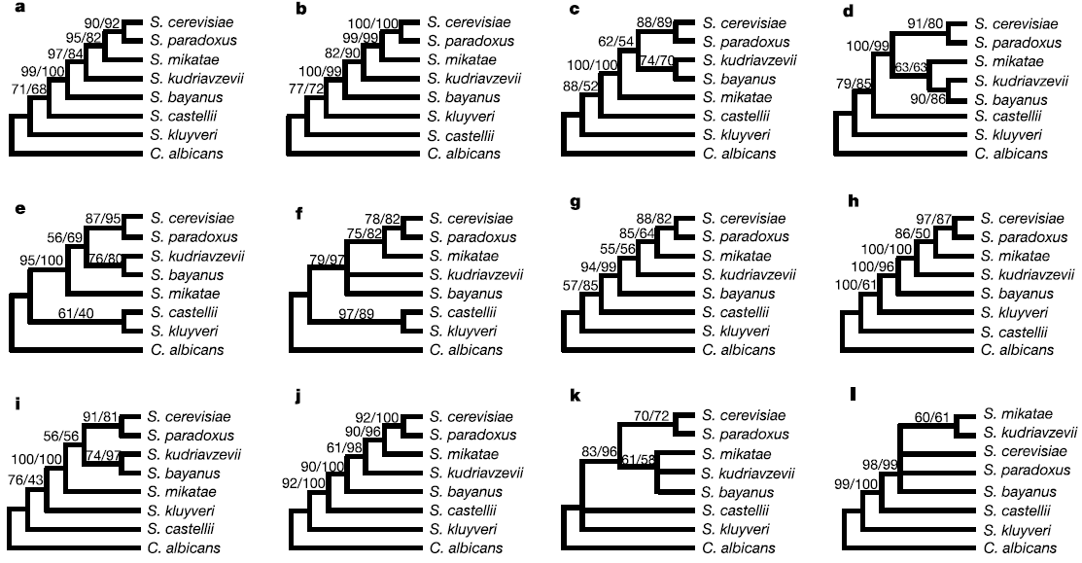
Single-gene data sets generate multiple, robustly supported alternative topologies.
Genome-scale approaches to resolving incongruence in molecular phylogenies. Antonis Rokas, Barry L Williams, Nicole King, Sean B Carroll (2003) Nature 425 (6960) p. 798-804

Slide 15
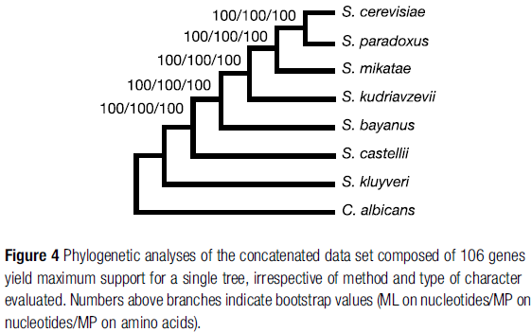
Concatenation
Right Topology
High Bootstrap Support
Genome-scale approaches to resolving incongruence in molecular phylogenies. Antonis Rokas, Barry L Williams, Nicole King, Sean B Carroll (2003) Nature 425 (6960) p. 798-804

Slide 16
Incorporating alignment uncertainty into Felsenstein’s phylogenetic bootstrap to improve its reliability
Chang, J.-M. et al. Bioinformatics btz082 (2019) doi:10.1093/bioinformatics/btz082.

Slide 17







If you build a tree,
ClustalW
Dalign
DCA
MAFFT
Muscle
ProbCons
T-Coffee
Which guy should I trust?
Notes:
older with more experience, or this handsome guy

Slide 18
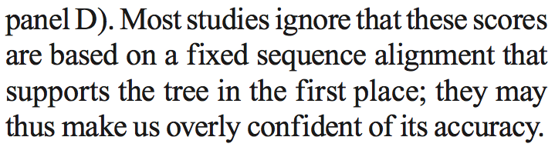
Ari Löytynoja and Nick Goldman, “Uniting Alignments and Trees,” Science 324, no. 5934 (June 19, 2009): 1528 -1529.

Slide 19
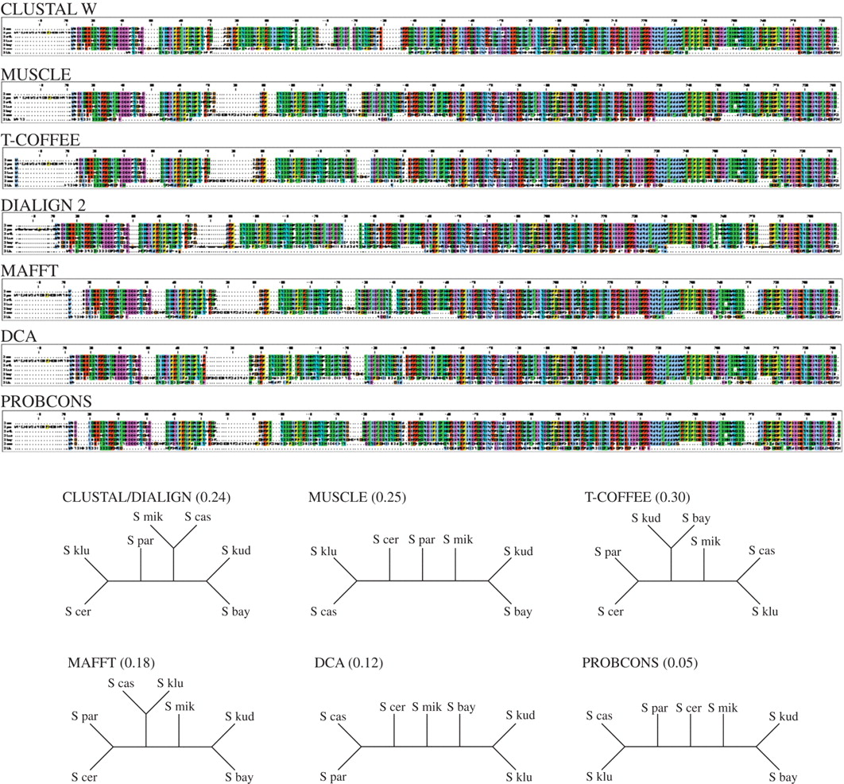
Which MSA Method ?
Wong, K. M., Suchard, M. A. & Huelsenbeck, J. P. Alignment uncertainty and genomic analysis. Science 319, 473–6 (2008).

Slide 20
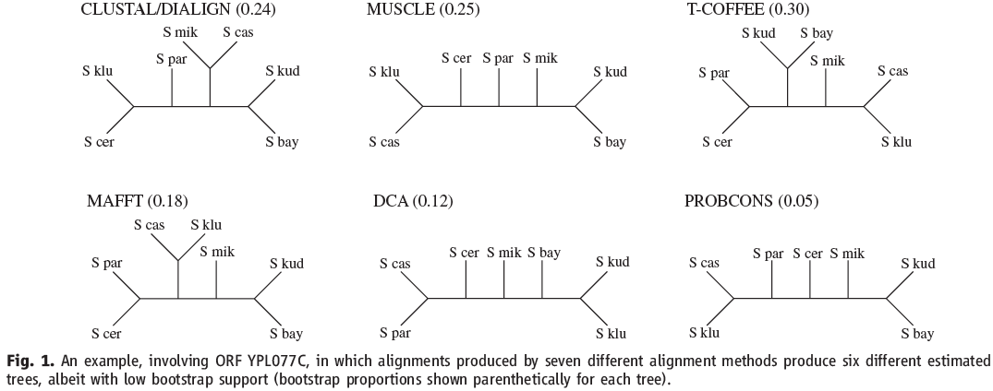
External alignment uncertainty
YPL077C with six topologies
Karen M Wong, Marc A Suchard, and John P Huelsenbeck, “Alignment uncertainty and genomic analysis”, Science 319, no. 5862 (January 25, 2008): 473-476.
Notes:
Of course, we trust smart guy but not blind.
is it only a rare case? or is it usual?
which tree topology is yeast ToL?

Slide 21
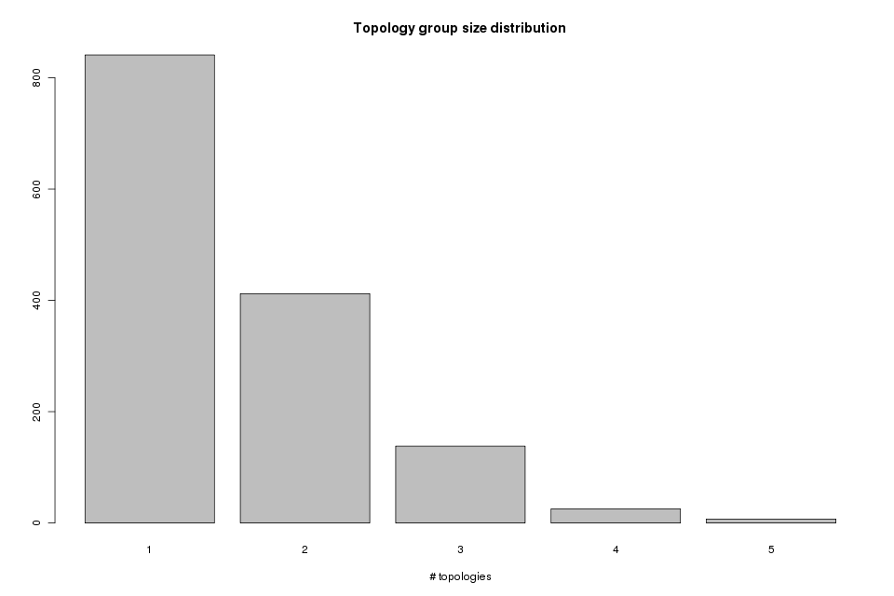
40.89%
Karen M Wong, Marc A Suchard, and John P Huelsenbeck, “Alignment uncertainty and genomic analysis”, Science 319, no. 5862 (January 25, 2008): 473-476.

Slide 22
YPL077C with six topologies
they have lower bootstraps
Does bootstrap help us to determine non-unique topologies?
Karen M Wong, Marc A Suchard, and John P Huelsenbeck, “Alignment uncertainty and genomic analysis”, Science 319, no. 5862 (January 25, 2008): 473-476.
Notes:
Of course, we trust smart guy but not blind.
is it only a rare case? or is it usual?

Slide 23
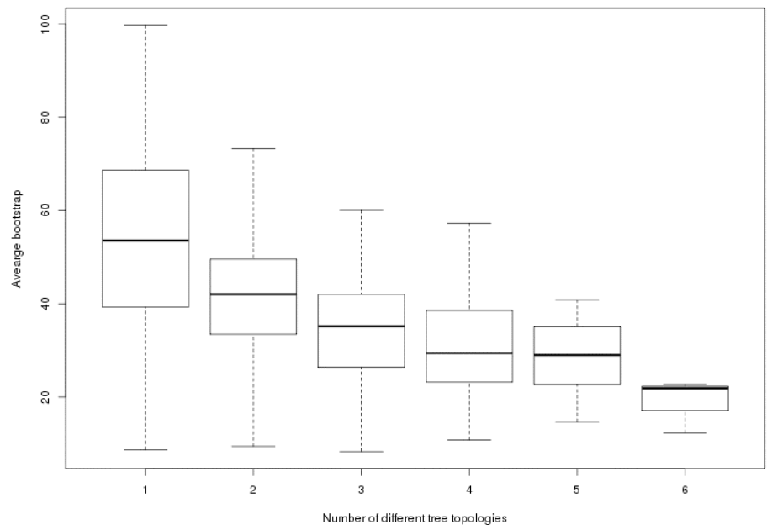
Number of different tree topologies versus average bootstrap values measured across the seven individual aligners.

Slide 24
Bootstrap vs Yeast tree
0.91
O
aligner1
0.65
X
0.23
O
0.89
O
aligner2
0.71
O
0.13
X
Rokas A, Williams BL, King N, Carroll SB: Genome-scale approaches to resolving incongruence in molecular phylogenies. Nature 2003, 425(6960):798-804.

Slide 25
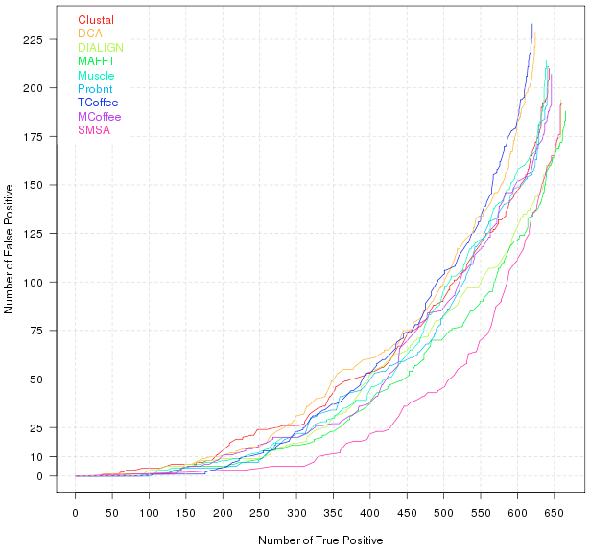
FP vs TP of the individual aligners
Notes:
Change color code: green can not see? Why does MAFFT so fast?

Slide 26
Super Multiple Sequence Alignment (SuperMSA)
Clustal
MAFFT
T-Coffee
S. cer
…
S. par
S. klu
…
S. cer
…
S. par
…
S. klu

Slide 27
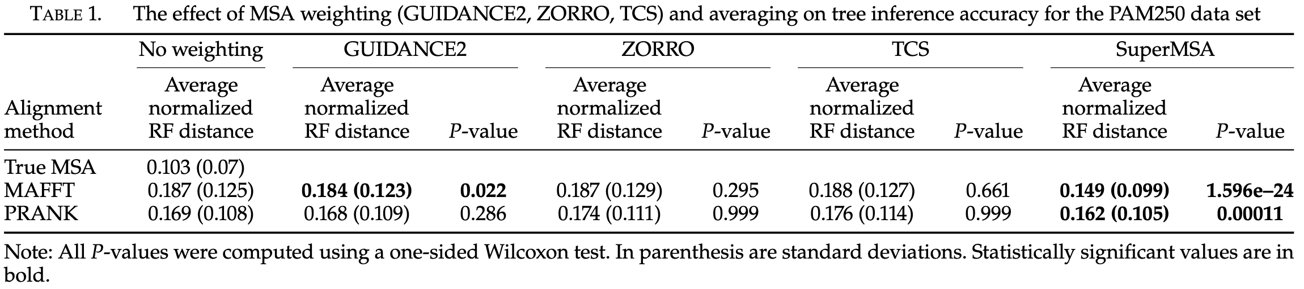
Multiple Sequence Alignment Averaging Improves Phylogeny Reconstruction – Systematic biology 2018
In this work we explore an approach, in which instead of relying on a single MSA, we generate a large set of alternative MSAs and concatenate them into a single SuperMSA. By doing so, we account for phylogenetic signals contained in columns that are not present in the single MSA computed by alignment algorithms.
Ashkenazy, H., Sela, I., Karin, E., Landan, G. & Pupko, T. Multiple sequence alignment averaging improves phylogeny reconstruction. Systematic biology (2018) doi:10.1093/sysbio/syy036.

Slide 28
SuperMSA vs SuperMSA?
Dear Chang,
Thank you for your kind email and it was nice meeting you.
I hope your manuscript is accepted and I think it is ok to compete - it just shows that we are doing science that is of interest to more than one person or group. Also, it is so much better to have faces behind names on a paper. ….
I will read your manuscript, and don't worry about the name, yes, we converged to the same name.
…
Best wises,
Tal.

Slide 29
FP vs TP of the individual aligners
50.62~52.82%
77.31%
Notes:
Change color code: green can not see? Why does MAFFT so fast?

Slide 30
Independently and Identically Distribution (i.i.d.)
”Given this independence of evolutionary processes in different characters, the configurations in the characters are seen to be drawn independently and identically distribution (i.i.d.), a necessary condition for the bootstrap method to be valid.“ – by Joseph Felsenstein.
Nucleic acid sequence data with p species
There are 4^{p} possible outcomes at each sites
Each site is independently drawn from a distribution with 4^{p} possibilities, whose possibilities depend on the phylogeny we are trying to estimate.
Felsenstein, J. Confidence Limits on Phylogenies: An Approach Using the Bootstrap. Evolution 39, 783 (1985).

Slide 31
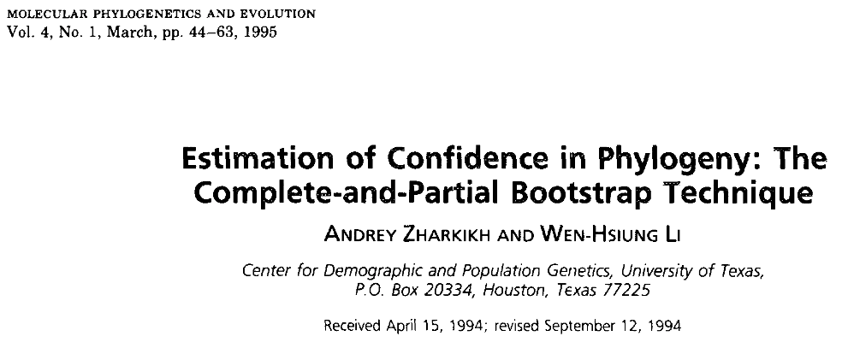
pSMSA & wpSMSA
Clustal
MAFFT
…
T-Coffee
S. cer
…
S. par
…
S. klu
partial
weighted
…
…
…
…
…
…
Zharkikh A, Li WH (1995) Estimation of confidence in phylogeny: the complete-and-partial bootstrap technique. Mol Phylogenet Evol 4: 44–63. doi:10.1006/mpev.1995.1005.

Slide 32
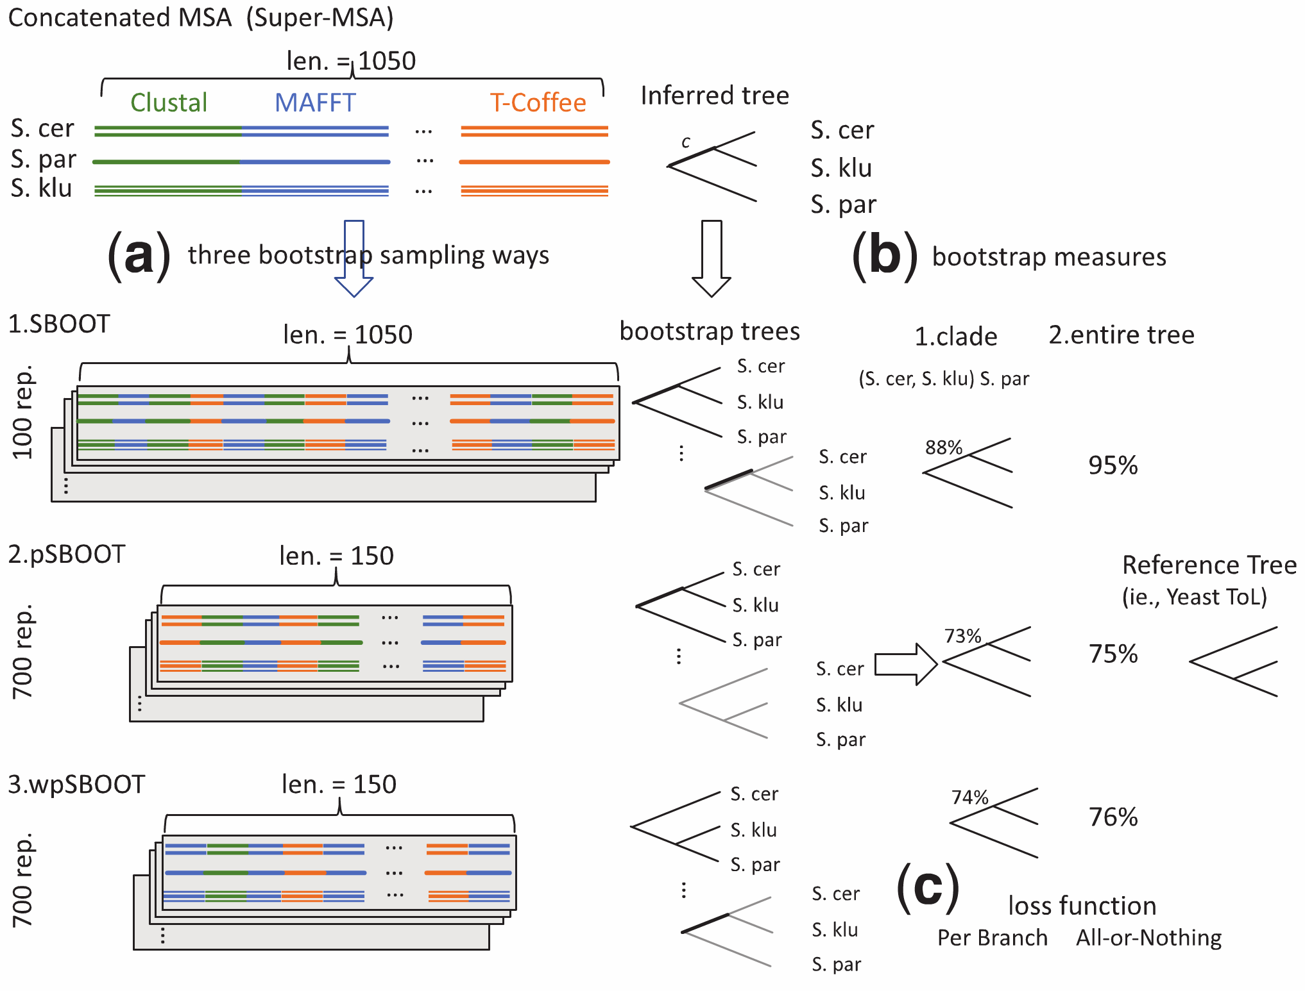

Slide 33
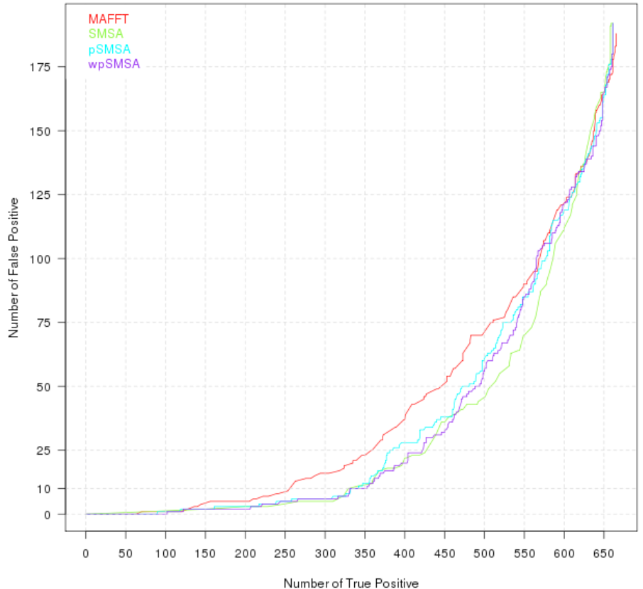
Alternative sampling procedures.

Slide 34
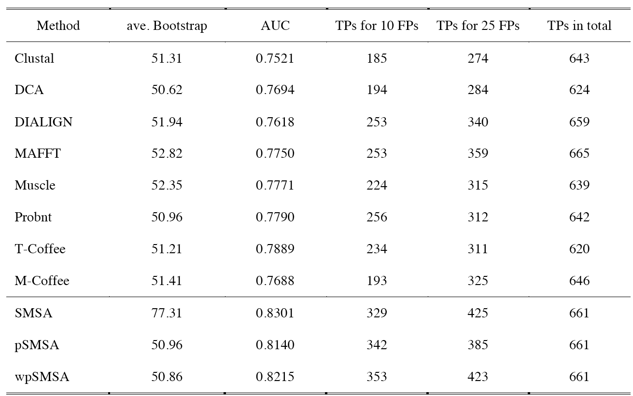
Average bootstrap, AUC values and the number of TPs for 10 and 25 accepted FPs of each method

Slide 35
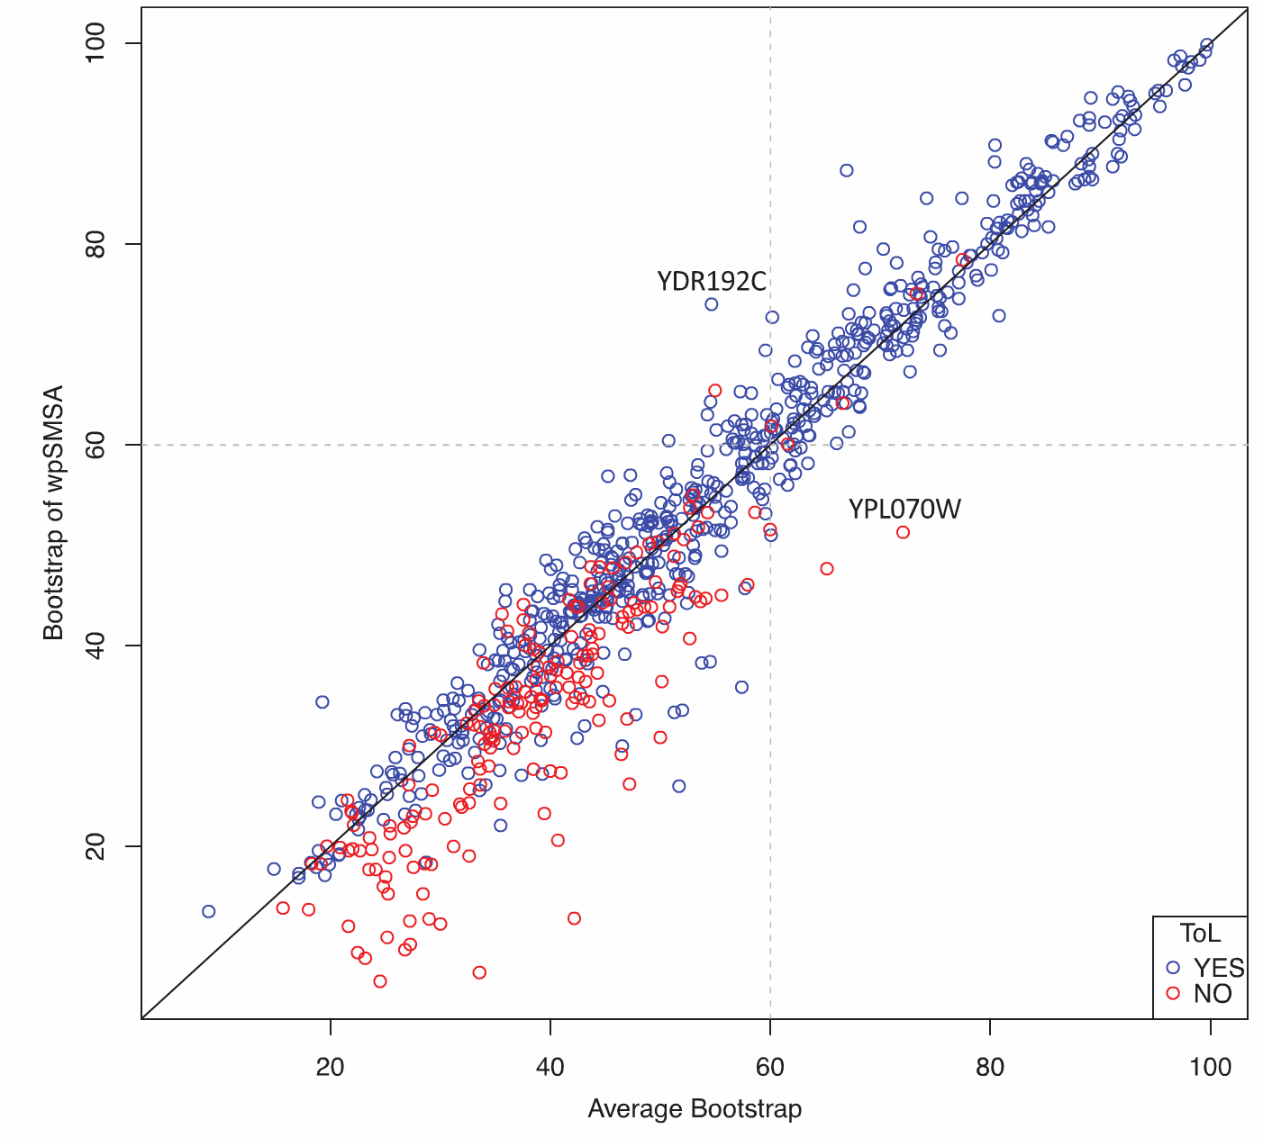
The bootstrap of wpSMSA versus the average bootstrap of individual aligners.
the wpSMSA topology == ToL

Slide 36
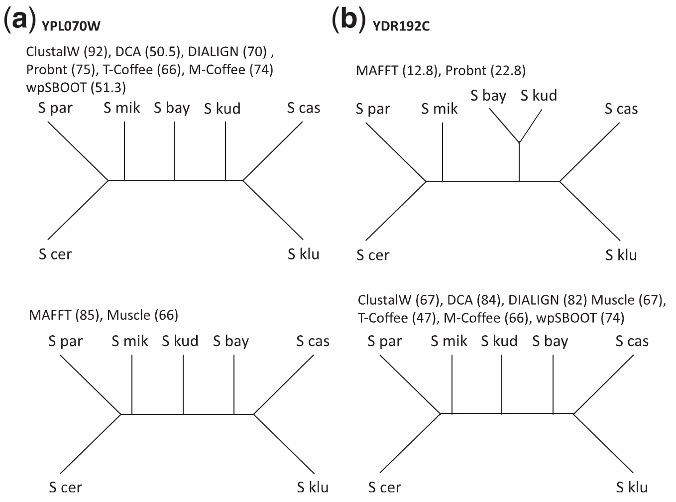
Correct Tree

Slide 37
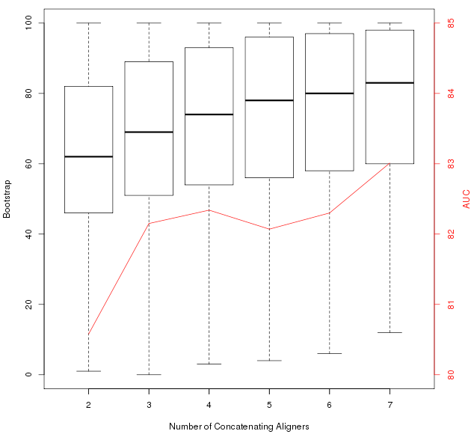
The average bootstrap and AUC (red line) of concatenating different number of aligners.

Slide 38

With real-life-size datasets, SATe-approach becomes useful and that should be included. (Wong et al. included seven somewhat arbitrarily chosen methods to demonstrate a problem. Any method that claims to *solve* the problem should beat the best existing methods and not to follow their decisions for a toy example.)
PRANK
Science. 2008 Jun 20;320(5883):1632-5
Phylogeny-aware gap placement prevents errors in sequence alignment and evolutionary analysis.
Löytynoja A, Goldman N.
SATe
Science. 2009 Jun 19;324(5934):1561-4.
Rapid and accurate large-scale coestimation of sequence alignments and phylogenetic trees.
Liu K, Raghavan S, Nelesen S, Linder CR, Warnow T.
reviewer

Slide 39
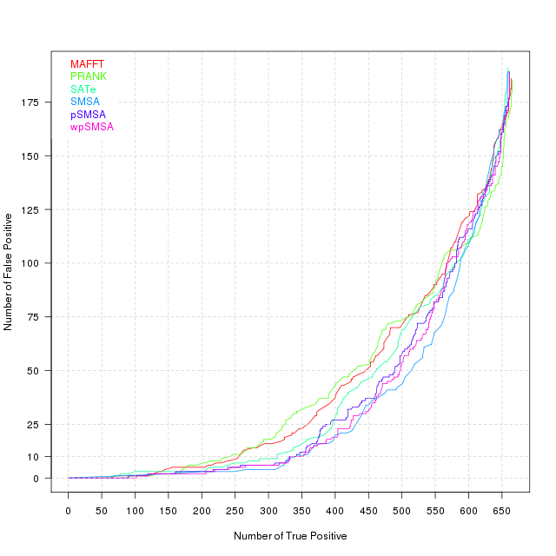

Slide 40
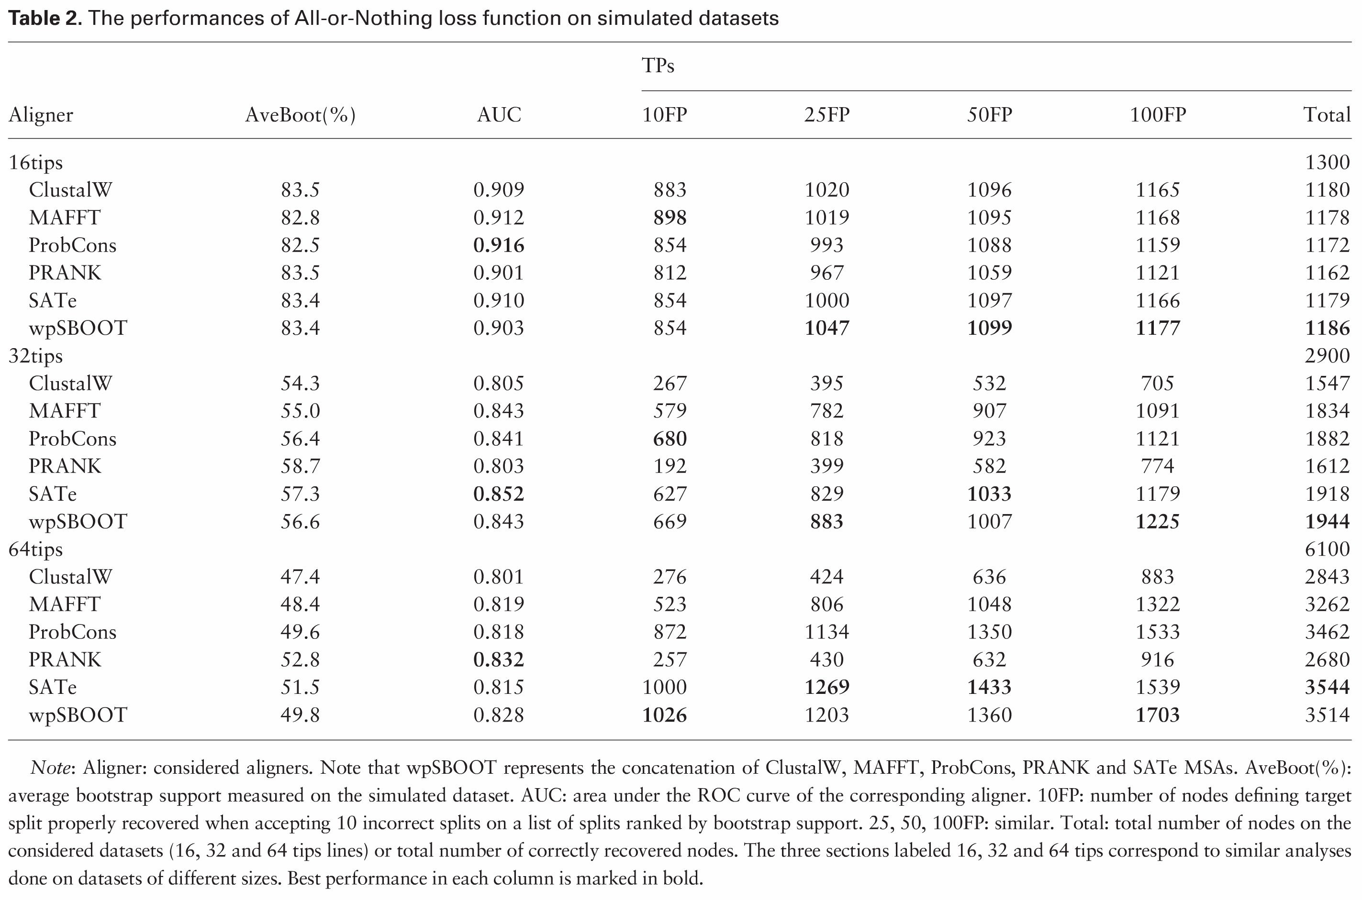

Slide 41
Recap
How to use sampling to enrich signal-to-noise ratio?
Which alignment should I use?

Slide 42
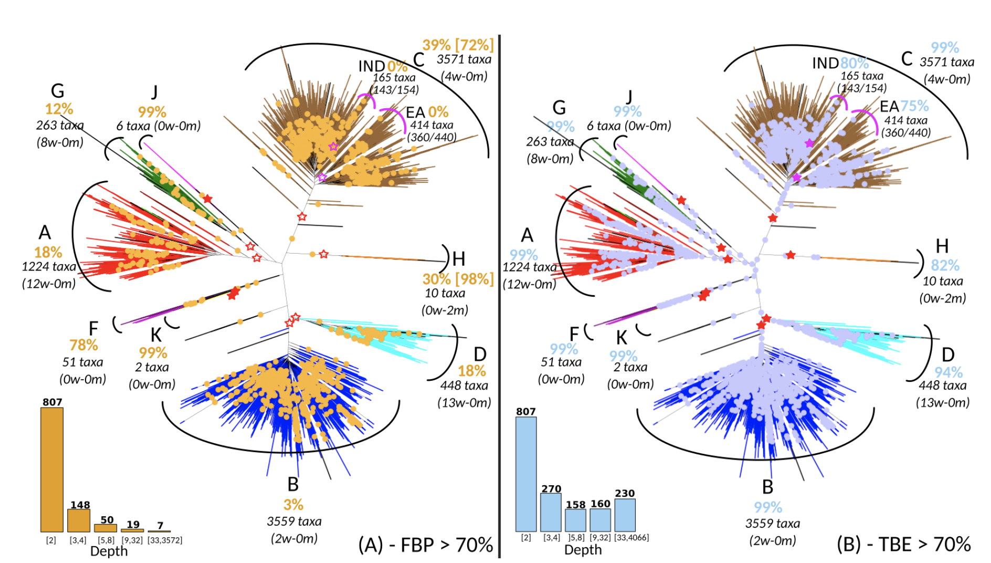
Boosting Felsenstein Phylogenetic Bootstrap
transfer distance, (b,b*) : a branch b of the reference tree T and a branch b* of a bootstrap tree T* is equal to the number of taxa that must be transferred (or removed), in order to make both branches identical
Felsenstein (FBP) and transfer (TBE) bootstrap supports on the same tree with 9,147 HIV-1M pol sequences
Lemoine, F. et al. Renewing Felsenstein’s phylogenetic bootstrap in the era of big data. Nature 556, 452–456 (2018).

